Slide 1






Operations & Management System
From teacher applications to contracts, from lessons to payments — end-to-end management in one platform.
Contracts
Calendar
Attendance
Messaging
Finance

Slide 2






What Is Portofedu?
An operations system through which an online course provider runs teacher hiring, lessons/scheduling, parent-student relationships, and payment processes from one place. Managers, staff, teachers, parents, and students all work from role-specific dashboards on the same platform.
Teacher Applications
Contract Management
Lessons & Calendar
Application form, interview slot, approval process
Teacher, parent, and student contracts, PDF generation
Group/course creation, slots, and Zoom integration
Attendance Tracking
Messaging & Support
Finance & Reporting
Attendance records and participation statistics
Inbox/outbox, bulk announcements, support tickets
Teacher earnings, payment approval, refunds, financial reports

Slide 3


Teacher Hiring Process
Managed in a single flow, from application to contract.
1. Pre-Application Form
2. Interview Slot Selection
3. Interview & Approval
4. Contract Signing
→
→
→
The candidate submits contact and profile details via the application form.
The candidate picks a suitable interview time from the calendar.
The manager reviews the application and approves or rejects it.
A contract is generated for the approved teacher and shared as a PDF.

Slide 4


Student Registration Process
There are two age-based registration paths, both handled from the same registration page.
Under 18
18 and Over
1
Parent Creates an Account
1
Fills Out the Registration Form
The parent selects “Parent Account” on the registration page and completes signup with their details.
Registration starts directly from the same page via the “18+ Student” option.
2
Adds the Student from the Dashboard
2
Date of Birth Is Verified
The parent enters the student’s name and date of birth from their own dashboard.
The system calculates age from the date entered; registration is rejected if under 18.
3
Automatically Approved
3
Account Is Instantly Active
Since the parent creates the account, no further approval is required.
The student can enroll in lessons with their own account, no parent required.

Slide 5


Lessons, calendar & operations management
Group / Private Course Management
Calendar & Zoom Integration
Course creation, student enrollment, teacher assignment, and category management.
Lesson slots are created and live-class links are matched automatically.
Attendance & Statistics
Messaging & Support Tickets
Attendance is recorded per lesson and participation reports are generated.
Inbox/outbox, bulk announcements, and support ticket management.

Slide 6



Finance & Reporting
Teacher Wallet & Earnings
Payment Approval
Monthly earnings are calculated and a wallet/invoice is generated for payment.
Incoming payments are reviewed and go through manager approval.
Refund Management
Financial Reports & Analytics
The refund process is handled for cancelled bookings.
Overall financial reports and payment analytics in one screen.

Slide 7



User Roles & Dashboards
Each role accesses the system through its own dedicated dashboard.
Manager
Staff
Teacher
Parent
Student
Manages applications, contracts, finance, and overall operations.
Assists the manager with day-to-day operations and support.
Tracks their lesson schedule, students, and earnings.
Registers their child, approves the contract, and tracks progress.
Views their lesson schedule and attendance from their own dashboard.

Slide 8
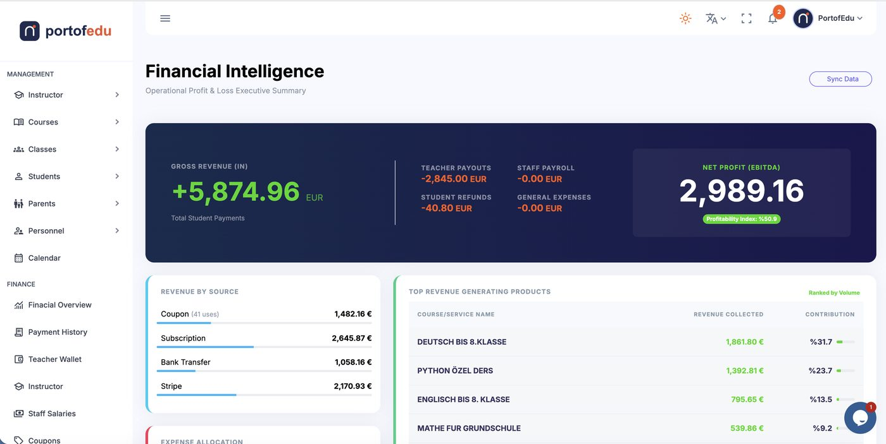
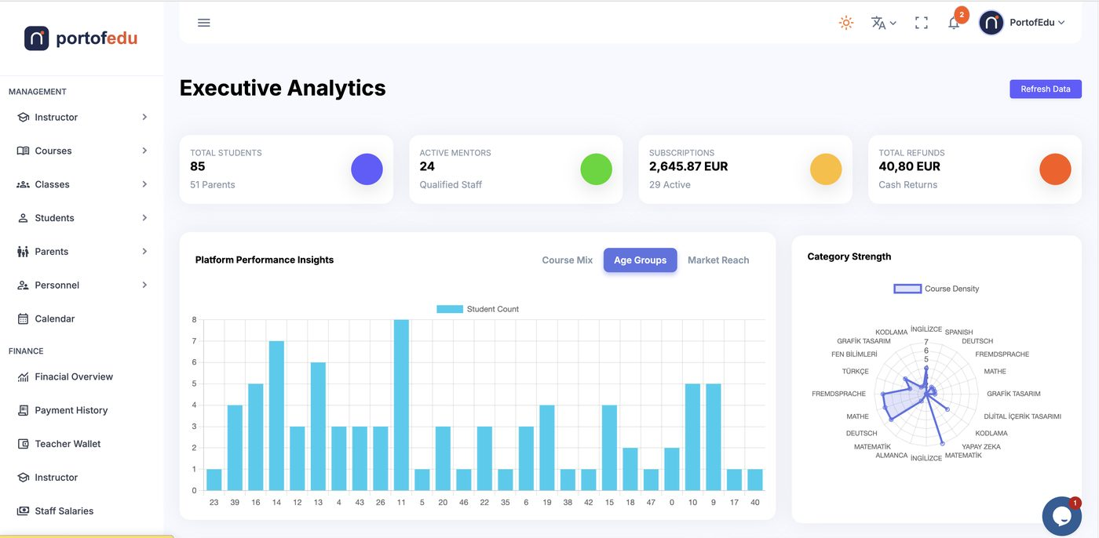
In-App Screenshots: Financial Overview
Revenue/expense summary and performance analytics — with live data.
Financial Intelligence
Executive Analytics

Slide 9
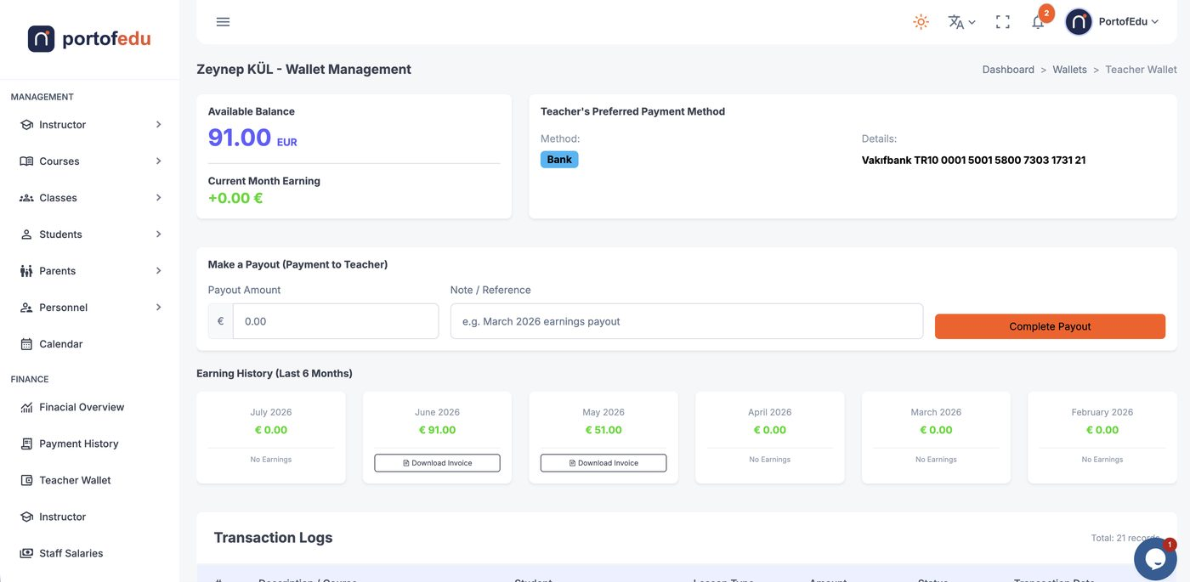
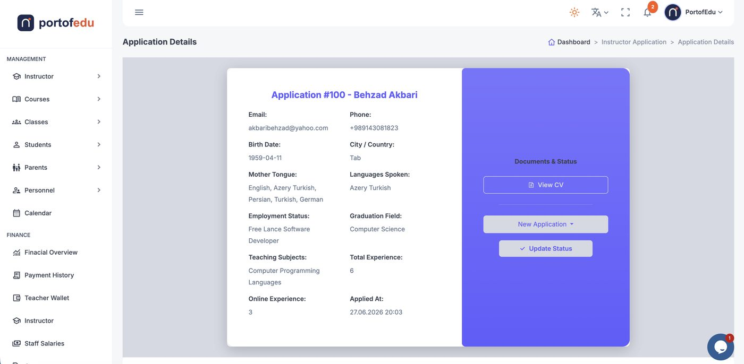
In-App Screenshots: Teacher Management
Teacher wallet and application review screens.
Teacher Wallet
Application Details

Slide 10
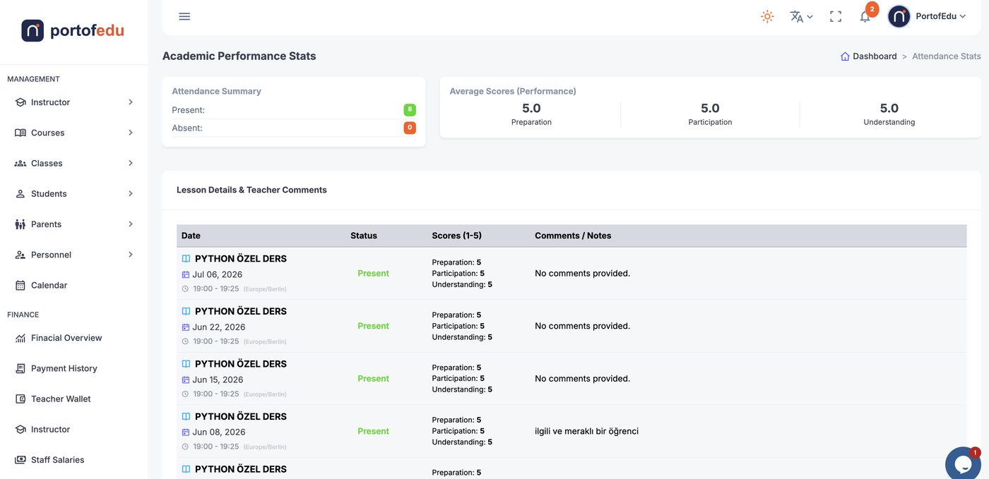
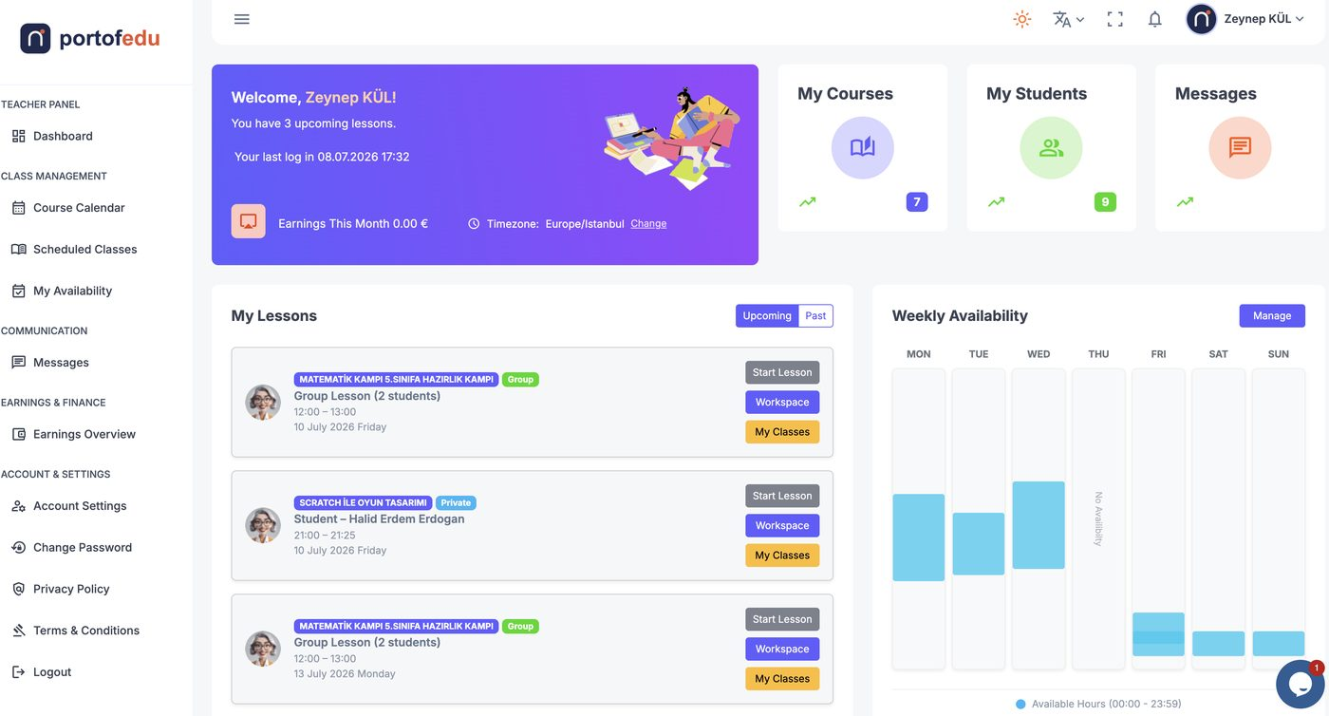
In-App Screenshots: Performance & Dashboard
Attendance/performance tracking and the teacher’s own dashboard.
Attendance & Performance
Teacher Dashboard

Slide 11
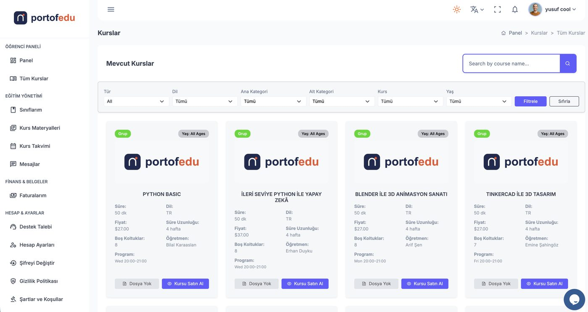
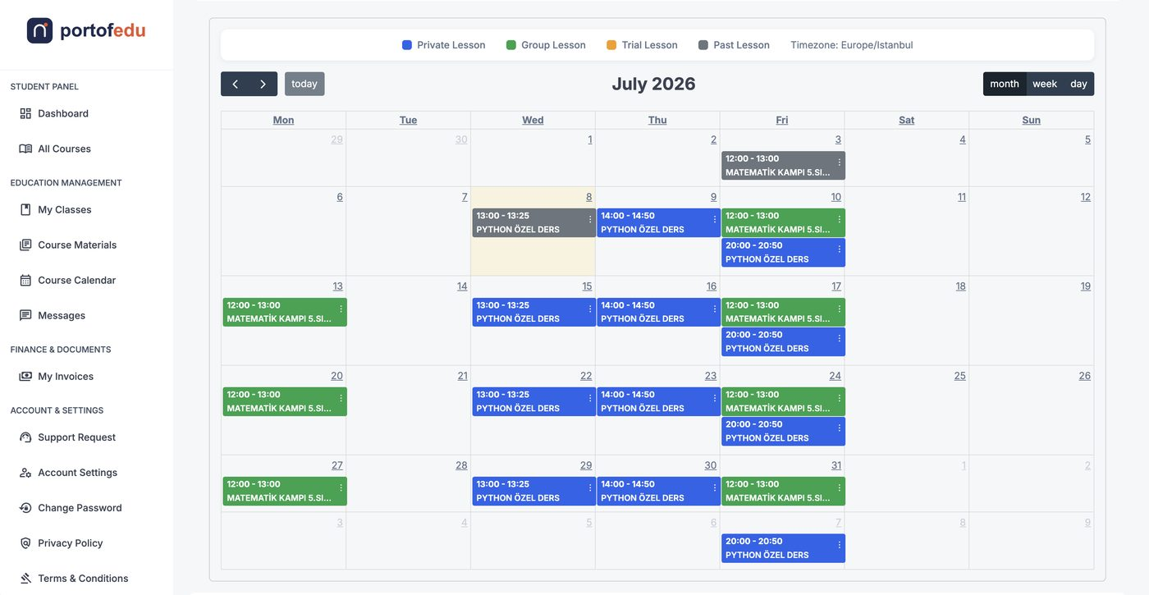
In-App Screenshots: Student Experience
Course catalog and lesson calendar — the screens students see.
Course Catalog
Lesson Calendar

Slide 12
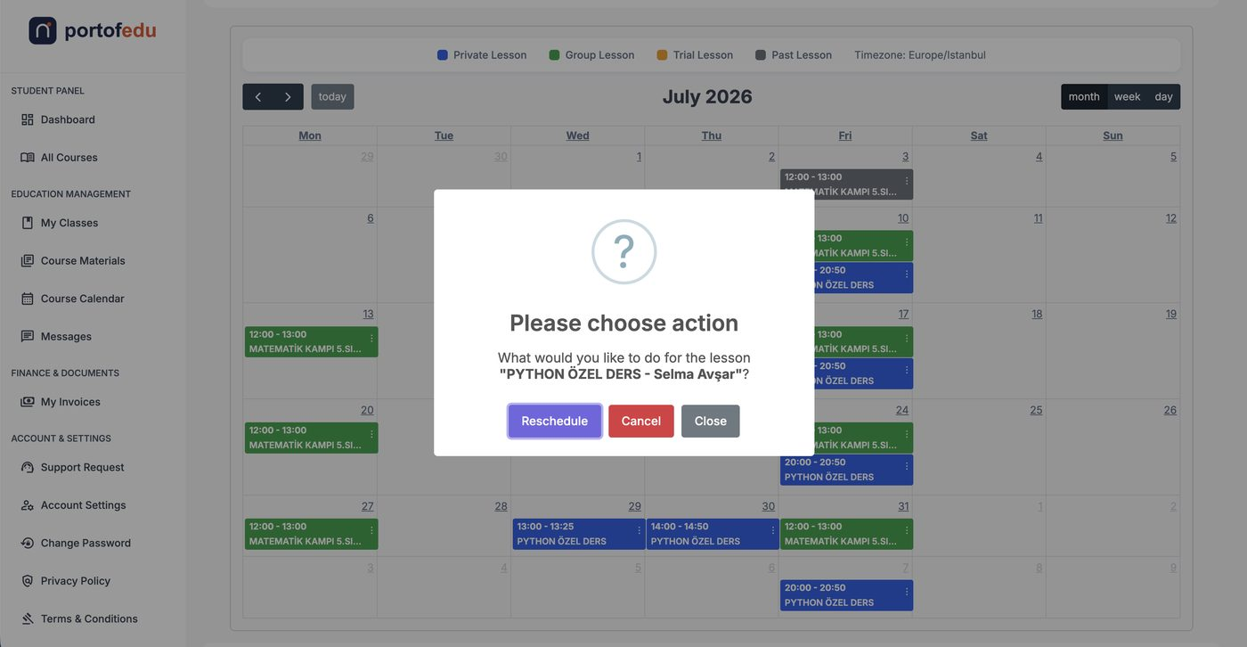
In-App Screenshots: Lesson Management
The flow for rescheduling or cancelling a lesson.
Lesson Action (Reschedule/Cancel)

Slide 13

What it is not
Common points of confusion, clarified:
Not a public course marketplace
Students can’t freely browse and buy courses; enrollment goes through a registration process.
Not an age-unrestricted registration platform
Under-18s cannot register directly; a parent creates the account. Those 18 and over can register themselves.
Not a content/video-hosting LMS
It doesn’t produce learning content; it manages the lesson, contract, and payment process.

Slide 14
From application to payment,
end-to-end management in one system.
Portofedu • Operations & Management System

